Slide 1



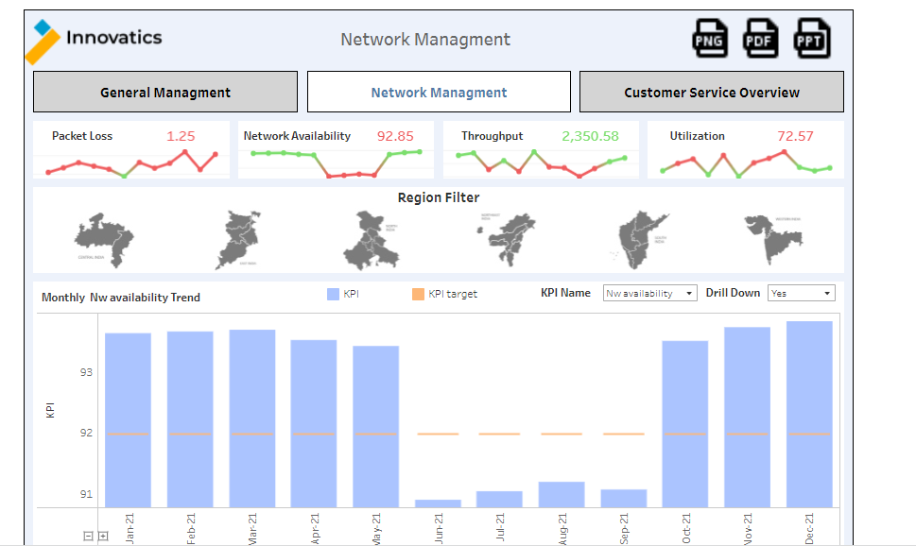
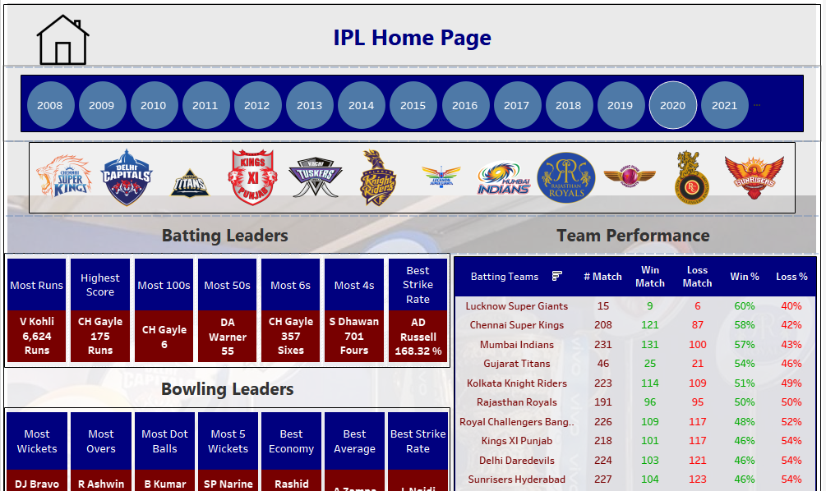
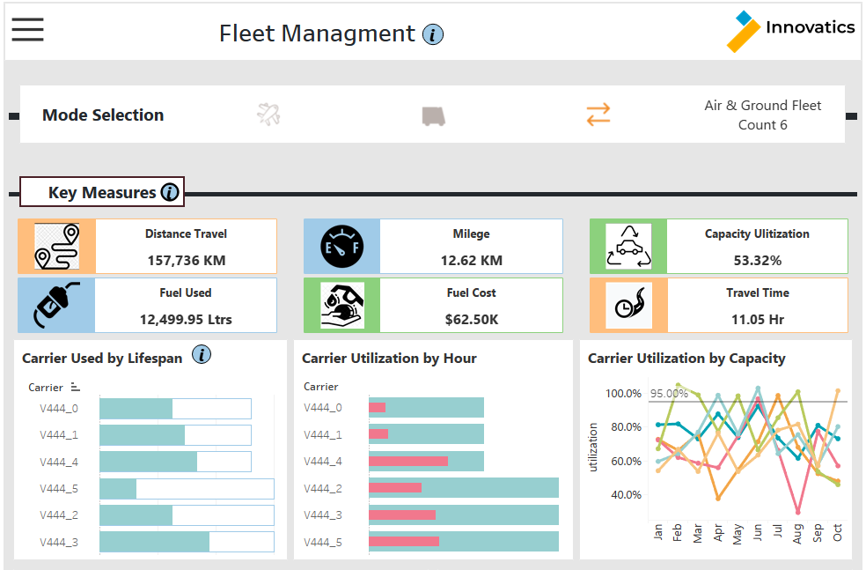
IPL Dashboard
Motive
Analytics Pipeline
Major Challenges
Which player need to retain or select that can be identify using this dashboard based on his previous performance.
Our Solution
Here We can track player’s performance since 2008-2022 overall where we can check best player in batting and bowling expects even on year level and team level as well.
In Venue level we can check player performance in different venue and which player are best in which venue that can be identified.
In team performance level tab we can check overall team level performance and on each match granularity and identify batting order for player and bowler selection based on performance.
Marketing Tools and Platforms
Data Transformation
Business Intelligence Tools
Overall data taken for IPL Dataset from Kaggle in different segments then set all as require format and using tab prep clean and define and then derive matrix from it
All received data will be stored and when require use from Excel work for further and some operation done on tableau prep as well.
Venue level,Team level,Year level and Idividual player performance check.
Help to Identify top players as per Venue requirement, Team based .
Dashboard Sample and Use Case
Dashboard
Benefits
Using this dashboard by select player based on previous performance we can improve batting order and create good score against opponent teams
Using this dashboard where player selection based on venue which help to make good score and improve performance of team.
Using this dashboard we can identify backup player when selected player injured so decide which other player opt based on his performance.
This dashboard shows a portion of what information can be viewed by Selector .
The use case shown here is for the Best player performance of the Overall player stats and check based on team and year.
Using each player stats in lower tab we can track individual player performance.
Venue performance dashboard shows each venue level team and player performance and Team level performance we check each team where which top 11 players for batting order and bowler are best for team that can be identify.
* Estimated

